Slide 1
A Sentiment Analysis of Thread App Reviews and Ratings With Explainable AI
CSE 713
Team - 07

Slide 2
Team Introduction
Mosa. Rabeya
Israt Jahan
Easha
Alvi Anowar
Md. Alkawser
Rahman
ID: 23266013
ID: 23266038
ID: 23366031
ID: 23366049

Slide 3
Introduction
Sentiment analysis in the context for threads app
reviews and ratings
Employs Advanced Machine learning algorithms and Explainable AI (XAI).
Enhanced Interpretability and Transparency.
Trusted and Reliable application ecosystem.

Slide 4
Literature Review
Reference | Proposed Model | Accuracy
Anirban Adak et al. | LSTM, Bi-LSTM, Bi-Gru-LSTM-CNN with XAI | 96.33% (Bi-GRU-LSTM-CNN )
Nurdin et al. | DL with XAI(LIME, SHAP, Anchor) | 94.3%
Noor at el. | Lexicon, SVM | 87.33%

Slide 5
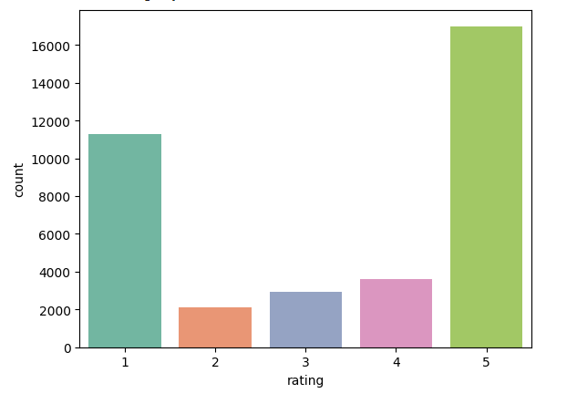
Data Collection
Kaggle dataset collection of Thread app’s review and ratings.
Over 37000 reviews collected from google play store and apple app store..

Slide 6
Data Pre-Processing
Used unigram feature extraction for dataset labeling.
Provided extensive synonyms and similarities.
Aided in determining content polarity.
Divided the dataset into negative and positive segments.
Rating 3 converted to None (missing or neutral).
Removed rows with missing values (dropna).
Converted the "rating" column to integer.

Slide 7
Dataset Pre-Processing
Lowercase all characters.
Remove mentions, URLs, symbols, punctuation,
Removed excessive leading and trailing spaces.
Filter single characters, stop words
Pre-Processed the "review_description" column.
Improved consistency and suitability for NLP tasks.
Converted text data into numeric vectors capturing term significance.
Enabled use in machine learning models requiring numerical input.

Slide 8

Methodology
We have used 5 models for Prediction
Logistic Regression
Decision Tree
Random Forest
LGBM
Support Vector Machine
Interpretable Model
SHAP

Slide 9
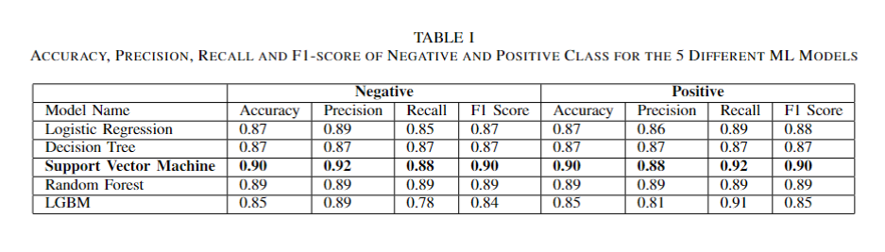
Result Analysis

Slide 10
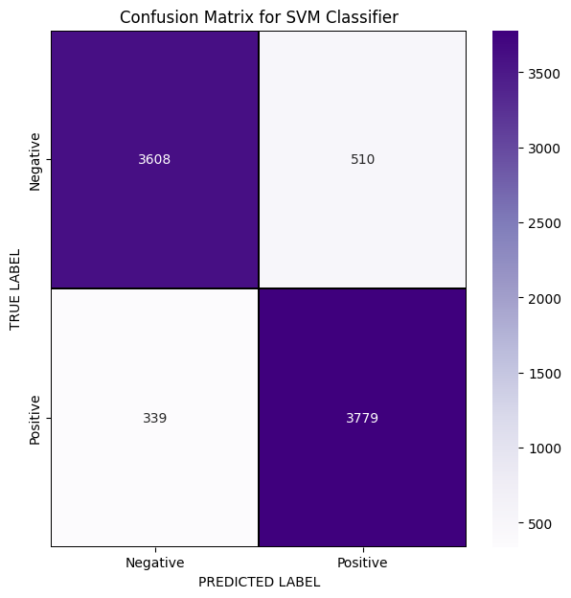
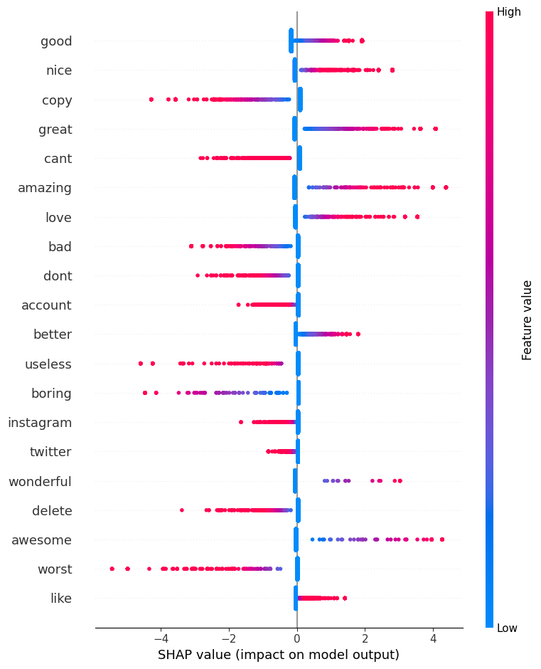
Result Analysis(Continue)
Figure 01
Figure 02

Slide 11
Challenges
Sarcasm and Irony
Ambiguity
Domain-specific Language
Emojis and Emoticons
Cultural and Regional Variations
Subjectivity and Personal Bias
Short Texts
Handling Mixed Sentiments

Slide 12
Conclusions
In conclusion, we use the dataset from Kaggle to train our model, while leveraging a diverse range of classes for heightened accuracy. By incorporating sentiment analysis and explainable Artificial Intelligence (XAI) features into our deep learning algorithm, we aim to enhance the model's prediction.

Slide 13
Future Statement
May be use more combinational model.
Could be use more classes and data.
Could be explore integrating real time monitoring capabilities through IoT devices for proactive and timely text and rating identification.
May be collaborate globally to access datasets so that to increase the model ability to detect text review .

Slide 14
References
Adak, A.; Pradhan, B.; Shukla, N.; Alamri, A. Unboxing Deep Learning Model of Food Delivery Service Reviews Using Explainable Artificial Intelligence (XAI) Technique. Foods 2022, 11, 2019. https://doi.org/10.3390/foods 11142019
A. Diwali, K. Saeedi, K. Dashtipour, M. Gogate, E. Cambria and A. Hussain, "Sentiment Analysis Meets Explainable Artificial Intelligence: A Survey on Explainable Sentiment Analysis," in IEEE Transactions on Affective Computing, doi: 10.1109/TAFFC.2023.3296373.
Adi, D.; Nurdin, N. Explainable Artificial Intelligence (Xai) Towards Model Personality in Nlp Task. IPTEK J. Eng. 2021, 7, 1. [CrossRef]
Sakinah, S.N.; Mohamed, A.; Mutalib, S. Customer Reviews Analytics on Food Delivery Services in Social Media: A Review. IAES Int. J. Artif. Intell. 2020, 9, 691. [CrossRef]

Slide 15

Thanks!
Do you have any question?

